Slide 1
Standard I/O Library

Slide 2
Contents
Standard I/O Library
Specified by the ISO C standard
Handles buffer allocation → Makes it easy to use → So as not to recognize what’s going on
Majorly written by Dennis Ritchie (1975)

Slide 3
FILE Objects
FILE object
Stream based
Byte orientation vs. multi-byte(wide) orientation
A structure containing all the information needed for the standard I/O library
The file descriptor
A pointer to a buffer for the stream
The size of the buffer
The number of characters currently in the buffer
An error flag,
And so on.
Three default streams (defined in <stdio.h>)
stdin, stdout, and stderr corresponding to STDIN_FILENO, STDOUT_FILENO, STDERR_FILENO, respectively

Slide 4
Buffering
Goal of buffering
Minimize the number of read() and write() calls
3 types
Fully buffering
I/O timing : Buffer is filled
Ex: File stream
Line buffering
I/O timing : a newline character is encountered
Ex: Terminal stream
Unbuffered
I/O timing : immediately
Ex: Standard error stream

Slide 5
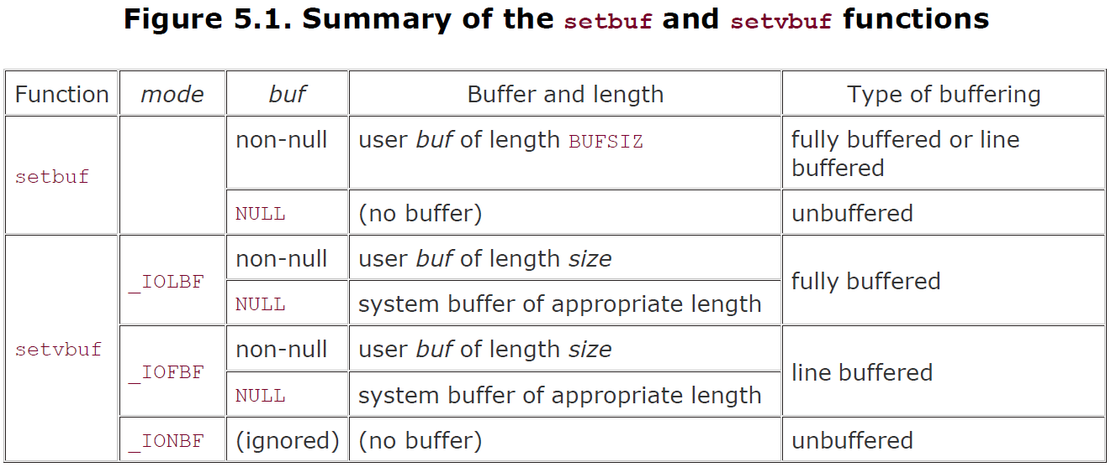
setbuf( )
Change the buffering
Called after the stream has been opened, but before any other operation is called
#include <stdio.h>
void setbuf(FILE *fp, char *buf);
int setvbuf(FILE *fp, char *buf, int mode, size_t size);
Return: 0 if OK, nonzero on error

Slide 6
fflush( )
Force any unwritten data for the stream to be passed to the kernel
#include <stdio.h>
int fflush(FILE *fp);
Return: 0 if OK, EOF on error

Slide 7
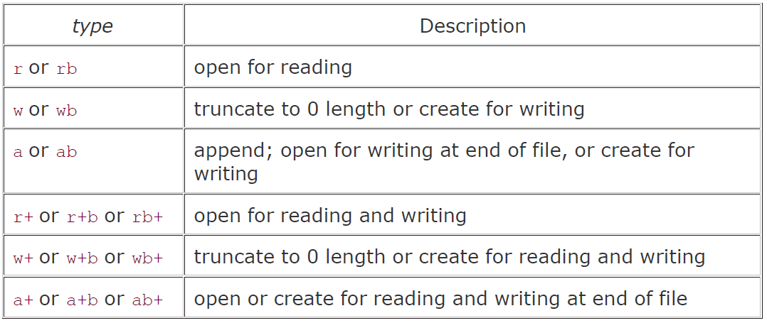
fopen( )
freopen
Close the file and reopen with orientation cleared
fdopen
Often used for pipes and device files
#include <stdio.h>
FILE *fopen(const char *pathname, const char *type);
FILE *freopen(const char *pathname, const char *type, FILE *fp);
FILE *fdopen(int filedes, const char *type);
All Return: file pointer if OK, NULL on error

Slide 8
fclose( )
#include <stdio.h>
int fclose(FILE *fp);
All Return: 0 if OK, EOF on error

Slide 9
Read and Write
3 types of I/O
Character-at-a-time I/O
Line-at-a-time I/O
Direct (Binary) I/O

Slide 10
Character-at-a-time
Input functions
Output functions
getc()/putc() is macro vs. fgetc()/fputc() is not macro
getchar() = getc(stdin), putchar() = putc(stdout)
#include <stdio.h>
int getc(FILE *fp);
int fgetc(FILE *fp);
int getchar(void);
All Return: next character if OK, EOF on end of file or error
#include <stdio.h>
int putc(int c, FILE *fp);
int fputc(int c, FILE *fp);
int putchar(int c);
All Return: c if OK, EOF on error
int ungetc(int c, FILE *fp);
All Return: c if OK, EOF on error

Slide 11
Line-at-a-time
Input functions
fgets() : Null-byte terminated & no more than n-1 characters are read
gets() : Never used.
Output functions
#include <stdio.h>
char *fgets(char *buf, int n, FILE *fp);
char *gets(char *buf);
Both return: buf if OK, NULL on end of file or error
#include <stdio.h>
int fputs(const char *str, FILE *fp);
int puts(const char *str);
Both return: non-negative value if OK, EOF on error

Slide 12
Binary I/O
Limitation
read() & write() should be used on the same system
Example
#include <stdio.h>
size_t fread(void *ptr, size_t size, size_t nobj, FILE *fp);
size_t fwrite(const void *ptr, size_t size, size_t nobj, FILE *fp);
Both return: number of objects read or written
float data[10];
if (fwrite(&data[2], sizeof(float), 4, fp) != 4)
err_sys("fwrite error");
struct {
short count;
long total;
char name[NAMESIZE];
} item;
if (fwrite(&item, sizeof(item), 1, fp) != 1)
err_sys("fwrite error");

Slide 13
Positioning a Stream
whence
SEEK_SET, SEEK_CUR, SEEK_END
#include <stdio.h>
long ftell(FILE *fp);
Returns: current file position indicator if OK, 1L on error
int fseek(FILE *fp, long offset, int whence);
Returns: 0 if OK, nonzero on error
void rewind(FILE *fp);

Slide 14
Formatted I/O
Output
Input
#include <stdio.h>
int printf(const char *format, ...);
int fprintf(FILE *fp, const char *format, ...);
Both return: number of characters output if OK, negative value if output error
int sprintf(char *buf, const char *format, ...);
int snprintf(char *buf, size_t n, const char *format, ...);
Both return: number of characters if OK, negative value if encoding error
#include <stdio.h>
int scanf(const char *format, ...);
int fscanf(FILE *fp, const char *format, ...);
int sscanf(const char *buf, const char *format, ...);
All three return: number of input items assigned, EOF if input error or end of file before any conversion

Slide 15
Example
#include "apue.h"
void pr_stdio(const char *, FILE *);
int main(void)
{
FILE *fp;
fputs("enter any character\n", stdout);
if (getchar() == EOF) err_sys("getchar error");
fputs("one line to standard error\n", stderr);
pr_stdio("stdin", stdin);
pr_stdio("stdout", stdout);
pr_stdio("stderr", stderr);
if ((fp = fopen("/etc/motd", "r")) == NULL) err_sys("fopen error");
if (getc(fp) == EOF) err_sys("getc error");
pr_stdio("/etc/motd", fp);
exit(0);
}
void pr_stdio(const char *name, FILE *fp)
{
printf("stream = %s, ", name);
/* The following is nonportable. */
if (fp->_IO_file_flags & _IO_UNBUFFERED) printf("unbuffered");
else if (fp->_IO_file_flags & _IO_LINE_BUF) printf("line buffered");
else /* if neither of above */ printf("fully buffered");
printf(", buffer size = %d\n", fp->_IO_buf_end - fp->_IO_buf_base);
}

Slide 16
Execution
$ ./a.out stdin, stdout, and stderr connected to terminal
enter any character
we type a newline
one line to standard error
stream = stdin, line buffered, buffer size = 1024
stream = stdout, line buffered, buffer size = 1024
stream = stderr, unbuffered, buffer size = 1
stream = /etc/motd, fully buffered, buffer size = 4096
$ ./a.out < /etc/termcap > std.out 2> std.err
run it again with all three streams redirected
$ cat std.err
one line to standard error
$ cat std.out
enter any character
stream = stdin, fully buffered, buffer size = 4096
stream = stdout, fully buffered, buffer size = 4096
stream = stderr, unbuffered, buffer size = 1
stream = /etc/motd, fully buffered, buffer size = 4096

Slide 17
Temporary Files
#include <stdio.h>
char *tmpnam(char *ptr);
Returns: pointer to unique pathname
FILE *tmpfile(void);
Returns: file pointer if OK, NULL on error
tmpfile
Creates a temporary binary file (type wb+) that is automatically removed when it is closed or on program termination.

Slide 18
Example
#include "apue.h"
int main(void) {
char name[L_tmpnam], line[MAXLINE];
FILE *fp;
printf("%s\n", tmpnam(NULL)); /* first temp name */
tmpnam(name); /* second temp name */
printf("%s\n", name);
if ((fp = tmpfile()) == NULL) /* create temp file */
err_sys("tmpfile error");
fputs("one line of output\n", fp); /* write to temp file */
rewind(fp); /* then read it back */
if (fgets(line, sizeof(line), fp) == NULL)
err_sys("fgets error");
fputs(line, stdout); /* print the line we wrote */
exit(0);
}
$ ./a.out
/tmp/fileC1Icwc
/tmp/filemSkHSe
one line of output

Slide 19
Memory Streams
#include <stdio.h>
FILE *fmemopen(void *restrict buf, size_t size, const char *restrict type);
Returns: stream pointer if OK, NULL on error
Create memory streams.

Slide 20
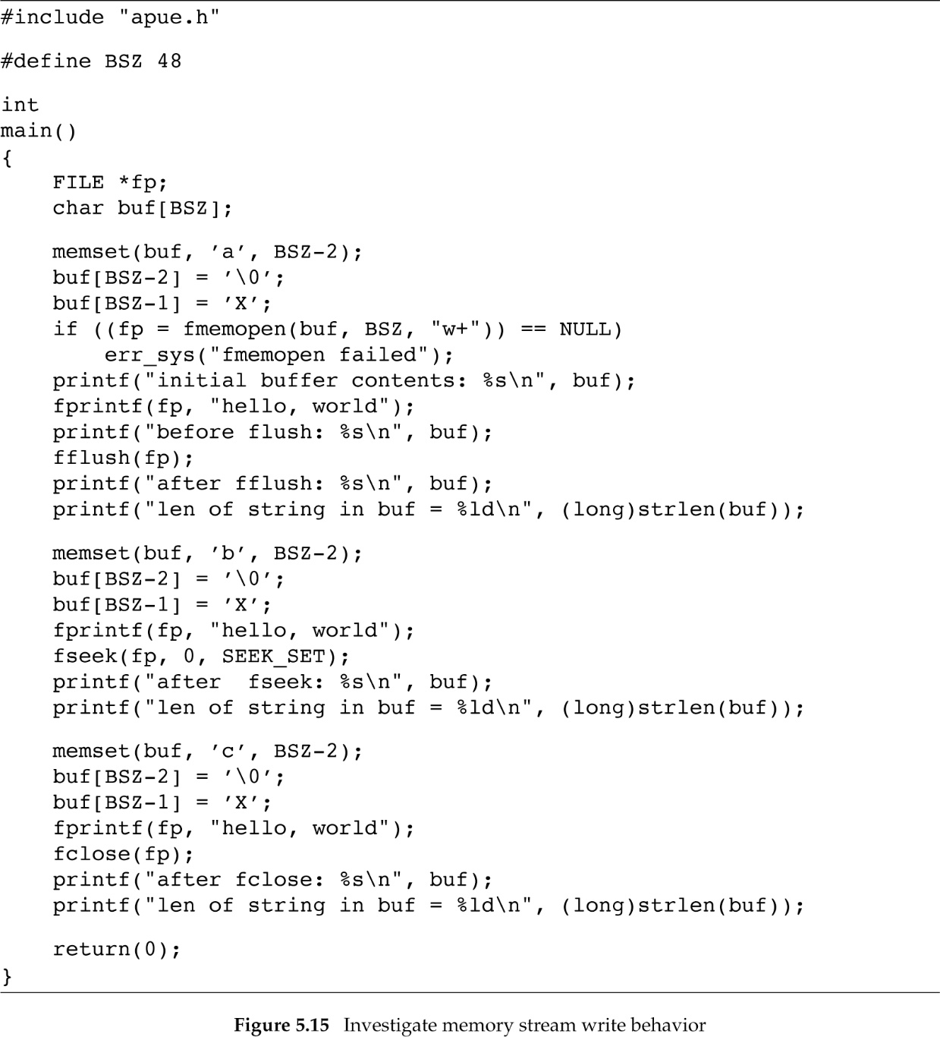
Example

Slide 21
Execution
$ ./a.out
overwrite the buffer with a’s
Initial buffer contents: fmemopen places a null byte at beginning of buffer
before flush: buffer is unchanged until stream is flushed
after fflush: hello, world
len of string in buf = 12 null byte added to end of string
now overwrite the buffer with b’s
after fseek: bbbbbbbbbbbbhello, world fseek causes flush
len of string in buf = 24 null byte appended again
now overwrite the buffer with c’s
after fclose: hello, worldcccccccccccccccccccccccccccccccccc
len of string in buf = 46 no null byte appended

